Slide 1
COMP90018 Mobile Computing Systems Programming
Tutorial on Android Development
Chu Luo, Ransi De Silva
chu.luo@unimelb.edu.au
ransidesilva@gmail.com

Slide 2
Welcome!
Outcomes of this tutorial:
Know the platform - Android
Know how Android Apps work
Create your first Android app

Slide 3

1. Android

Slide 4
Android Overview
Open source platform by Google
Linux kernel
Currently version 8.1 (updated very fast...)

Slide 5
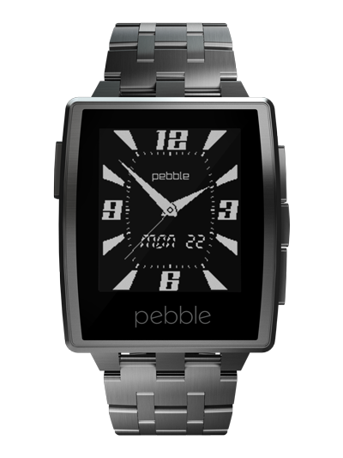

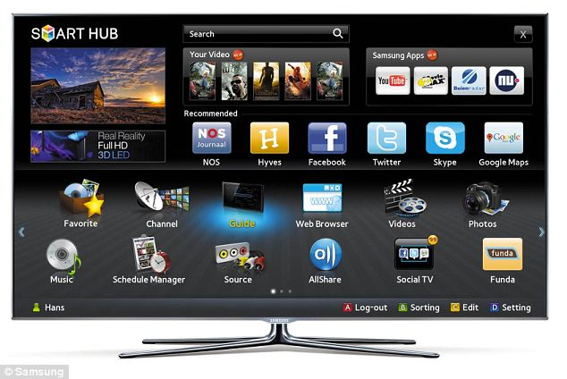
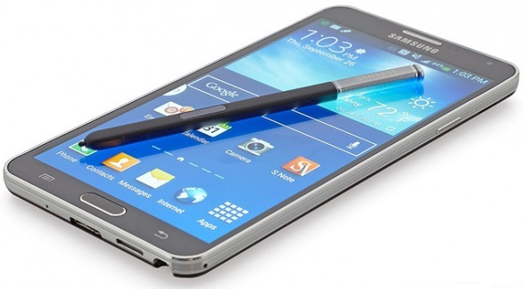
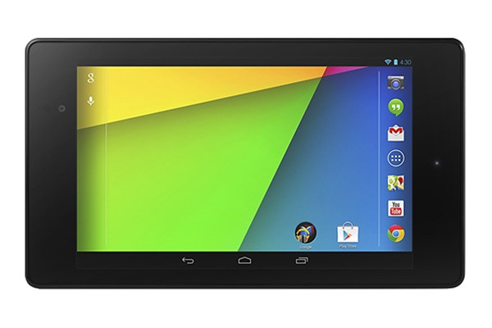
Devices of Android Platform
A large family of devices run on the Android platform
HTC One M8
Samsung Smart TV
Pebble SmartWatch
Samsung Galaxy Note 4
Google Nexus 7 Tablet
Android

Slide 6
2. Android Apps

Slide 7
Android Apps
Written in Java (or Kotlin)
Runtime Environment : Android Runtime (ART), on Android 5.0+
Not in Dalvik virtual machine (used before 5.0) any more

Slide 8
https://android.jlelse.eu/closer-look-at-android-runtime-dvm-vs-art-1dc5240c3924

Slide 9
http://www.anandtech.com/show/8231/a-closer-look-at-android-runtime-art-in-android-l

Slide 10
Four Components in Android Apps
Activity: foreground program
Service: background task
Broadcast Receiver: respond to events
Content Provider: read/write data on phone storage

Slide 11
3. Create your first Android app

Slide 12
Get the tool creating Android Apps
Android Studio: for Win, Mac, Linux
Current version 3.1.3

Slide 13
Also install Android SDK
Android Studio will help you install it

Slide 14
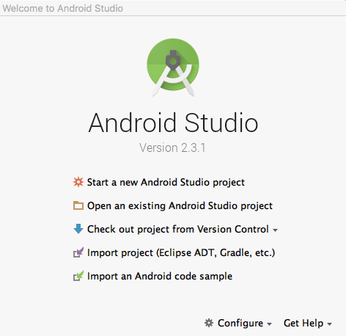
Create an app to show Hello World
Click this

Slide 15
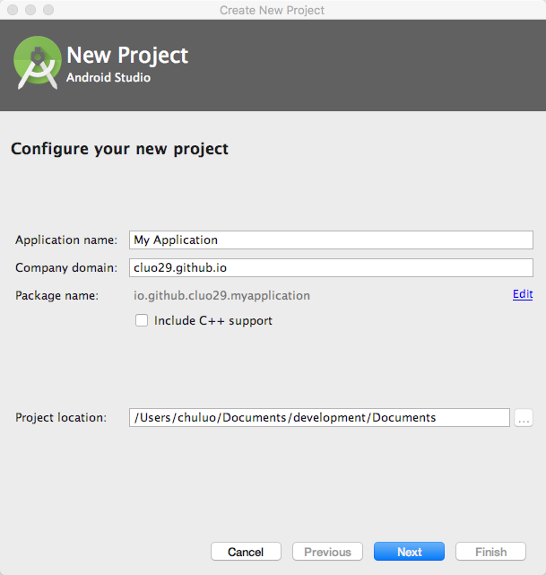
Input app info

Slide 16
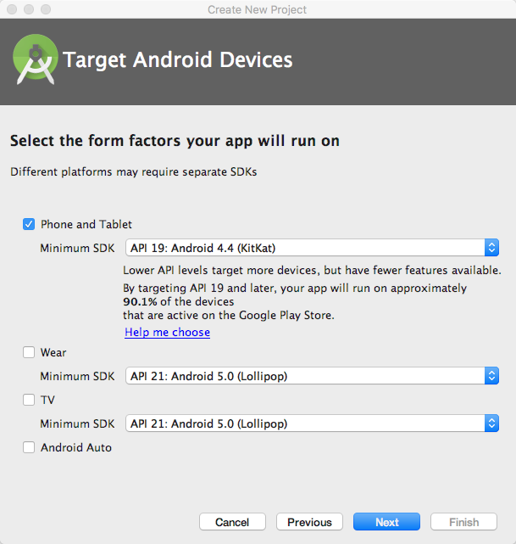
Min API
Must be lower than devices!

Slide 17
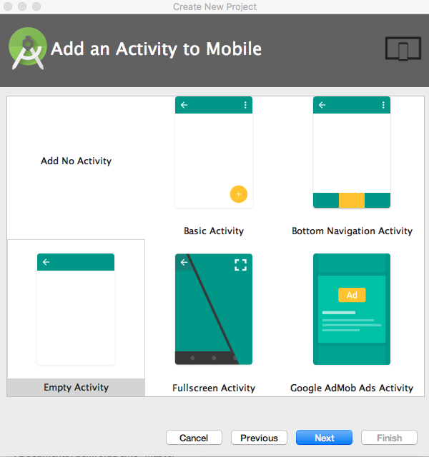
Activity
Choose empty

Slide 18
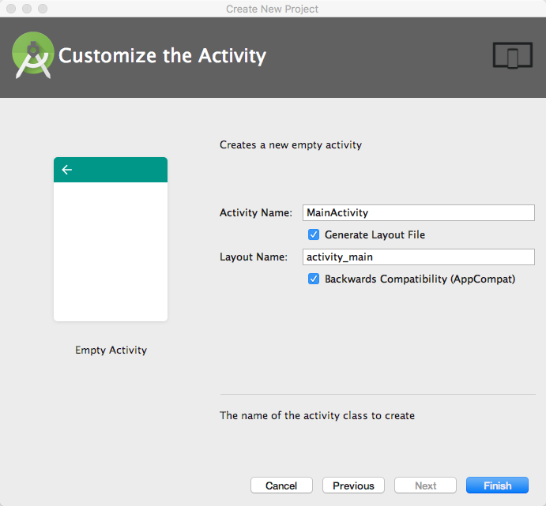
Keep the default and finish

Slide 19
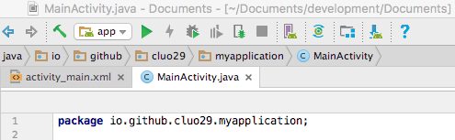
Click this to run the app

Slide 20
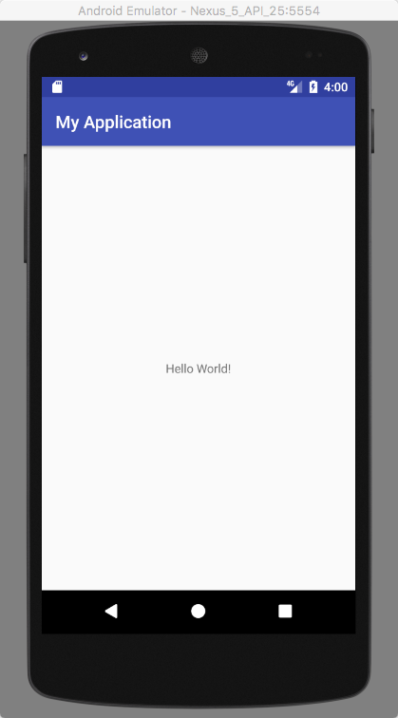
E.g., Create an Emulator and run

Slide 21
Homework: Run the app on a real device (phone/tablet)
Hint: <How to Enable USB Debugging Mode on Android>
https://www.kingoapp.com/root-tutorials/how-to-enable-usb-debugging-mode-on-android.htm

Slide 22
Implement your app
Add some Java code in onCreate()
E.g.:
int intA = 0; int intB = 1; Log.d("MyApp","value of A + B =" + (intA+intB)); Log.d("MyApp","line number =" + 18);

Slide 23
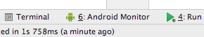
Log.d(””,””) for Debugging
In Android Monitor (bottom bar)
It shows the output:

Slide 24
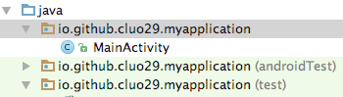
Add more activities?
[Right Click] your project package, then everything is easy

Slide 25
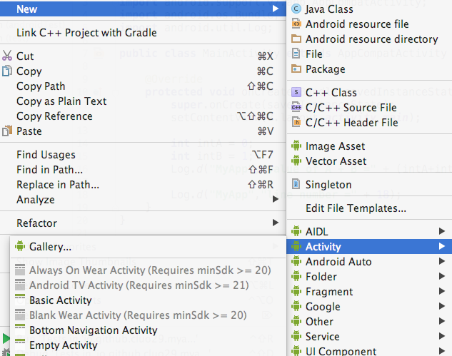

Slide 26
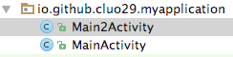
Now you have 2 activities

Slide 27
Link them together!
So let Activity 1 have a button.
Press that button to jump to Activity 2

Slide 28
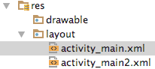
Add a button to the UI of Activity 1
In [project folder], go to res->layout

Slide 29
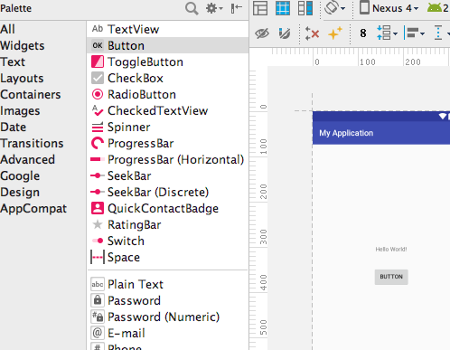
Drag a button to the UI

Slide 30
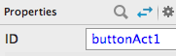
Change the button ID if you want. Make sure every UI item has its [UNIQUE] ID! (also understandable to avoid bugs!)

Slide 31
Go back to MainActivity.java

Slide 32
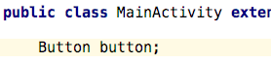
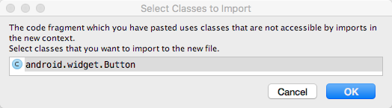
Add the code for the button
Android Studio auto import the class

Slide 33
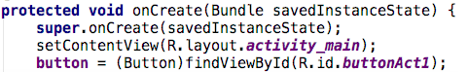
Link the button from UI to logic layer
Do it in onCreate()
//intent.putExtra("keyOne","Hello world");
(Type) findViewByID(R.id.#itemID#)

Slide 34
Add the code to jump from 1 to 2
button.setOnClickListener(new View.OnClickListener() { @Override public void onClick(View v) { // move from ActivityOne to ActivityTwo Intent intent = new Intent(MainActivity.this, Main2Activity.class); startActivity(intent); }});

Slide 35
To debug, add some code in Activity 2
In onCreate() (Activity 2’s java, not 1’s!)
Add: Log.d("MyApp","I am Activity 2");

Slide 36
Click this to run the app

Slide 37
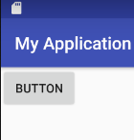
Press Button and See the effects

Slide 38
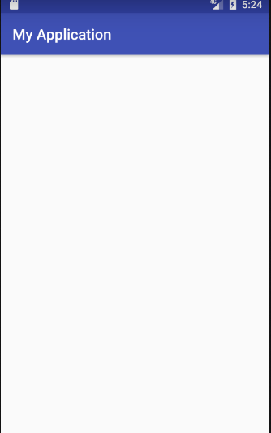
Effect 1: You see the empty UI from Activity 2

Slide 39
Effect 2: You see debugging info

Slide 40
More skills: Refactoring
The code is currently ugly!
But we can improve it!
By refactoring!

Slide 41
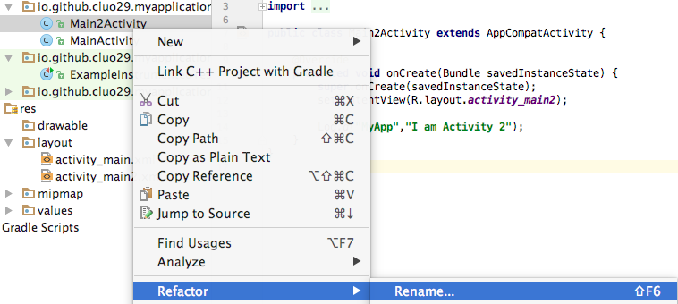
E.g., Give the activity a better name,
Just [Right Click] it and Refactor!

Slide 42
Build better activities
Managing the Lifecycle of an Activity.
Passing data across Activities.

Slide 43
Visit this link for more details!
https://stackoverflow.com/questions/8515936/android-activity-life-cycle-what-are-all-these-methods-for

Slide 44
Passing data across Activities
A send data to B when A creates B
B send data to A when B is about to die (so that A will be visible)

Slide 45
A send data to B when A creates B
Use putExtra() when A creates B
Use getStringExtra() (if the data type is String) when B receives the data

Slide 46
B send data to A when B is about to die
Use startActivityForResult() when A creates B
Use onActivityResult() Receive data from B
Tip: A should use a requestCode to identify which activity sends results

Slide 47
Well done!
Outcomes of this tutorial:
Know the platform - Android
Know how Android Apps work
Create your first Android app

Slide 48
To Build better Android apps
Use Log.d() to debug
Make code readable (refactor)
Manage the Activity Lifecycle
Pass data across Activities

Slide 49
When Seeing Errors/Bugs:
Read error message, then fix
Can’t fix? Google it
Or, go to Stackoverflow.com
If still not good, use LMS discussion board

Slide 50
What About Next Week?
Learn to use – Github (via Android Studio)
Android UI Design & Control
Background task: Service

Slide 51
See you next week COMP 90018
Tutorial on Android Development
Chu Luo, Ransi De Silva
chu.luo@unimelb.edu.au
ransidesilva@gmail.com

